Slide 1
North Carolina
Statewide Model
Vince Bernardin, PhD [in lieu of Roberto Miquel]
April 25, 2018

Slide 2
Agenda
LOOKING BACK
  Short Term Improvements for P5.0 – NCSTM3.0
LOOKING AHEAD
  Potential Improvements for P6.0 – NCSTM4.0
  Input from YOU!

Slide 3
NCSTM 3.0

Slide 4
Efficiency & Usability Improvements
  Converted the model to TransCAD 7 Build 12375
  Matrix conversions between .mtx and .csv only needed once
  Robust Java – TransCAD handshake
  Converted project-level evaluation and post-processing out of R and into GISDK
  Manual interventions (updating files paths in scripts, changing properties tokens) have been either eliminated or transferred to TransCAD interfaces
  All project analysis conducted via a new interface in the NCSTM

Slide 5
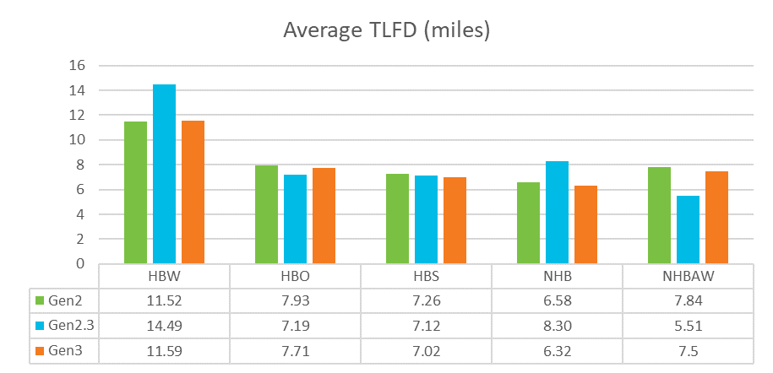
Destination Choice
  Focus on runtime improvements (15min down to 3min)
  Validation of trip length frequency distribution

Slide 6
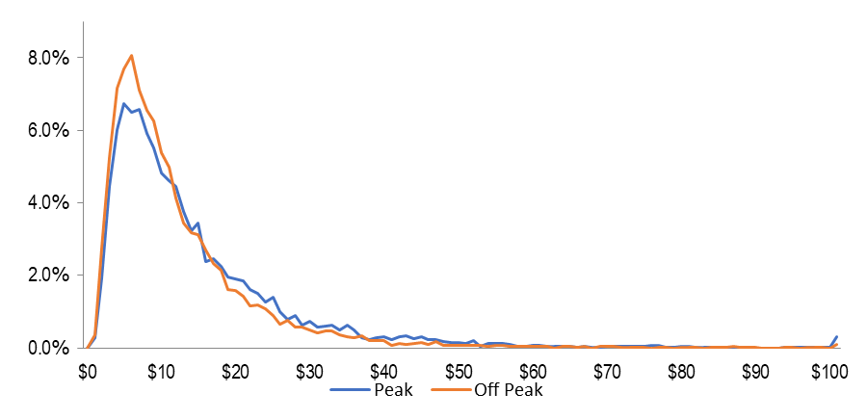
Sketch Toll Choice Modeling
FOR SKETCH LEVEL TOLL MODELING FOR PLANNING
Three stated preference surveys were combined to estimate value-of-time distributions
A mixed logit model was estimated and scaled using a multinomial logit model
Average Peak Period VOT by Income and Distance

Slide 7
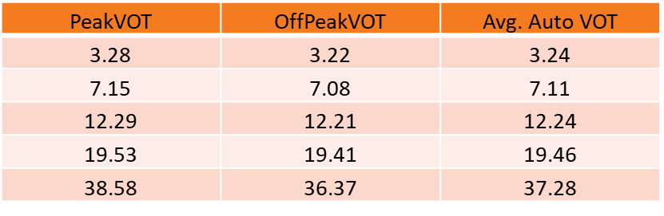
Sketch Toll Choice Modeling
  This VOT distributions estimated from the surveys were applied to the NCSTM and used to divide auto trips in to five market segments with the following average VOTs:

Slide 8
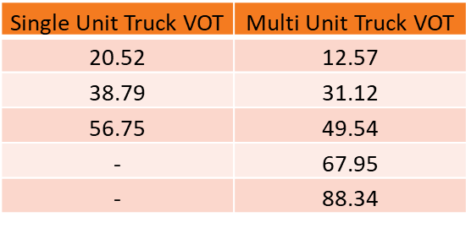
Sketch Toll Choice Modeling
  Similarly, five market segments were developed for muti-unit trucks and three for single unit trucks.

Slide 9
Sketch Toll Choice Modeling
  The toll model was calibrated for volumes on the Triangle Expressway by adding a calibration constant to scale up the travel time savings of toll roads to account for travel time reliability, and other factors ignored in this version of the model
  The final adjustment was a 50% increase in the benefit of toll roads, which is reasonable and broadly consistent with the contribution of reliability in other toll models

Slide 10
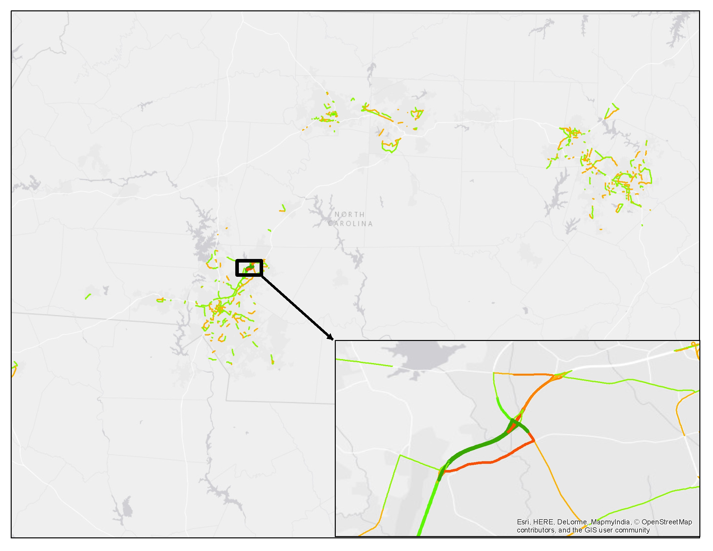
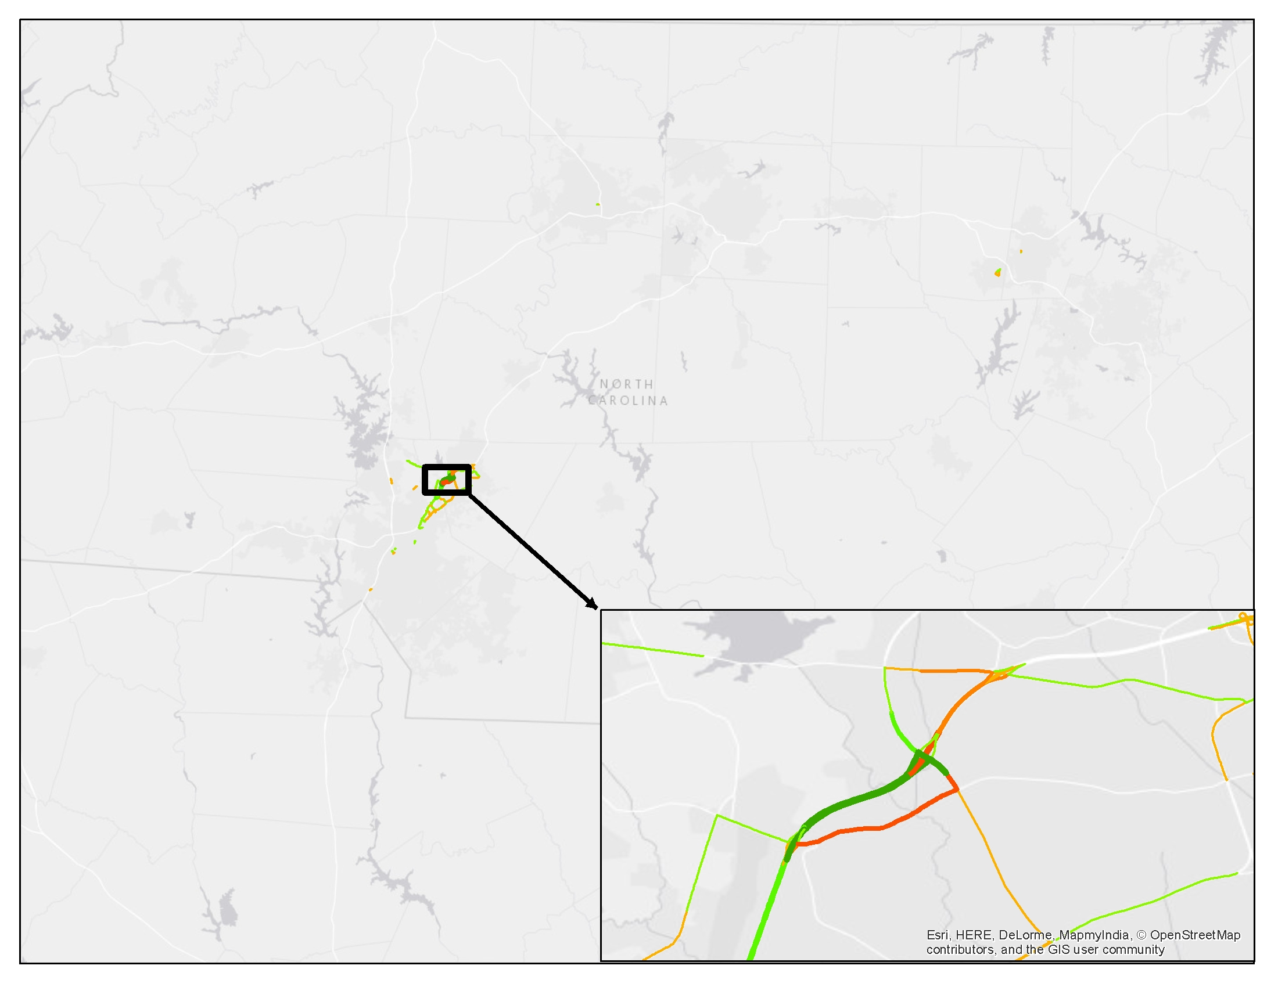
Traffic Assignment
NCSTM v. 2.3 (5 x 10⁻⁴)
NCSTM v. 2.3 (1 x 10⁻⁶)

Slide 11
Recalibration
  NCSTM v. 2.3 was out of calibration, substantially different from documented v. 2.0 results
  Whole model was re-calibrated to 2011 base year (in addition to toll model calibration to Triangle Expressway in 2015)
  Adjustments to free-flow speeds changed (mostly reduced)
  Weight on length term in generalized cost adjusted
  Trip rates had to be adjusted by area type and region
  Destination choice had to be recalibrated to reproduce TLFDs
  Posted speeds, ramp coding, etc., corrected near Triangle

Slide 12
Potential NCSTM 4.0 Improvements

Slide 13
TAZ Improvements
  Split TAZs (especially in rural counties), create separate zones for small towns distinct from surrounding rural areas
  Update SE data for base, improve employment data through use of multiple data sources (public & private)
  Improve SE forecasts for future, make consistent in some way with MPOs, create /automate relatively simple process/tool

Slide 14
Network Improvements
  Add network detail
  Update Freeflow Speed methodology using observed data
  Update E+C Network
  Quality review of all traffic data inputs
  Better modeling of ferries (possibly with toll choice)

Slide 15
Leverage Passive OD Data
  Both Passenger & Truck Data available
  Update special generators using passive OD and POI data
  Improve Distribution
    Option 1: Data Table Pivot
    Option 2: Incorporate into Destination Choice Model

Slide 16

The Problem
WE DON’T KNOW WHERE PEOPLE GO
  Where people are going (to & from) is the largest source of error in travel forecasts (by far). [Zhao & Kockelman, 2002]
WE NEED TO KNOW WHERE PEOPLE GO
  So that we can understand:
    If they would pay a toll
    If they might change modes (and walk, ride transit…)
    If deadheading restrictions on automated vehicles would
    be effective

Slide 17
The Power of Big Data
  TN STATEWIDE DATA
Combined household survey
  NHTS + 4 MPOs
  10,344 households
AirSage and ATRI datasets
  Trip Table (OD pairs)
    Total: 12,744,900
    Survey: 39,782 0.3%
    AirSage: 3,355,539 26.3%
  CHATTANOOGA DATA
2010 household survey
  1,502 households
AirSage and ATRI datasets
  Trip Table (OD pairs)
    Total: 529,984
    Survey: 8,350 2.0%
    AirSage: 182,742 34.5%

Slide 18


Can you recognize the pattern based on <2%?

Slide 19


How about based on >25%?

Slide 20
Big Data allows us to see the Big Picture

Slide 21

But what about this 25%?

Slide 22
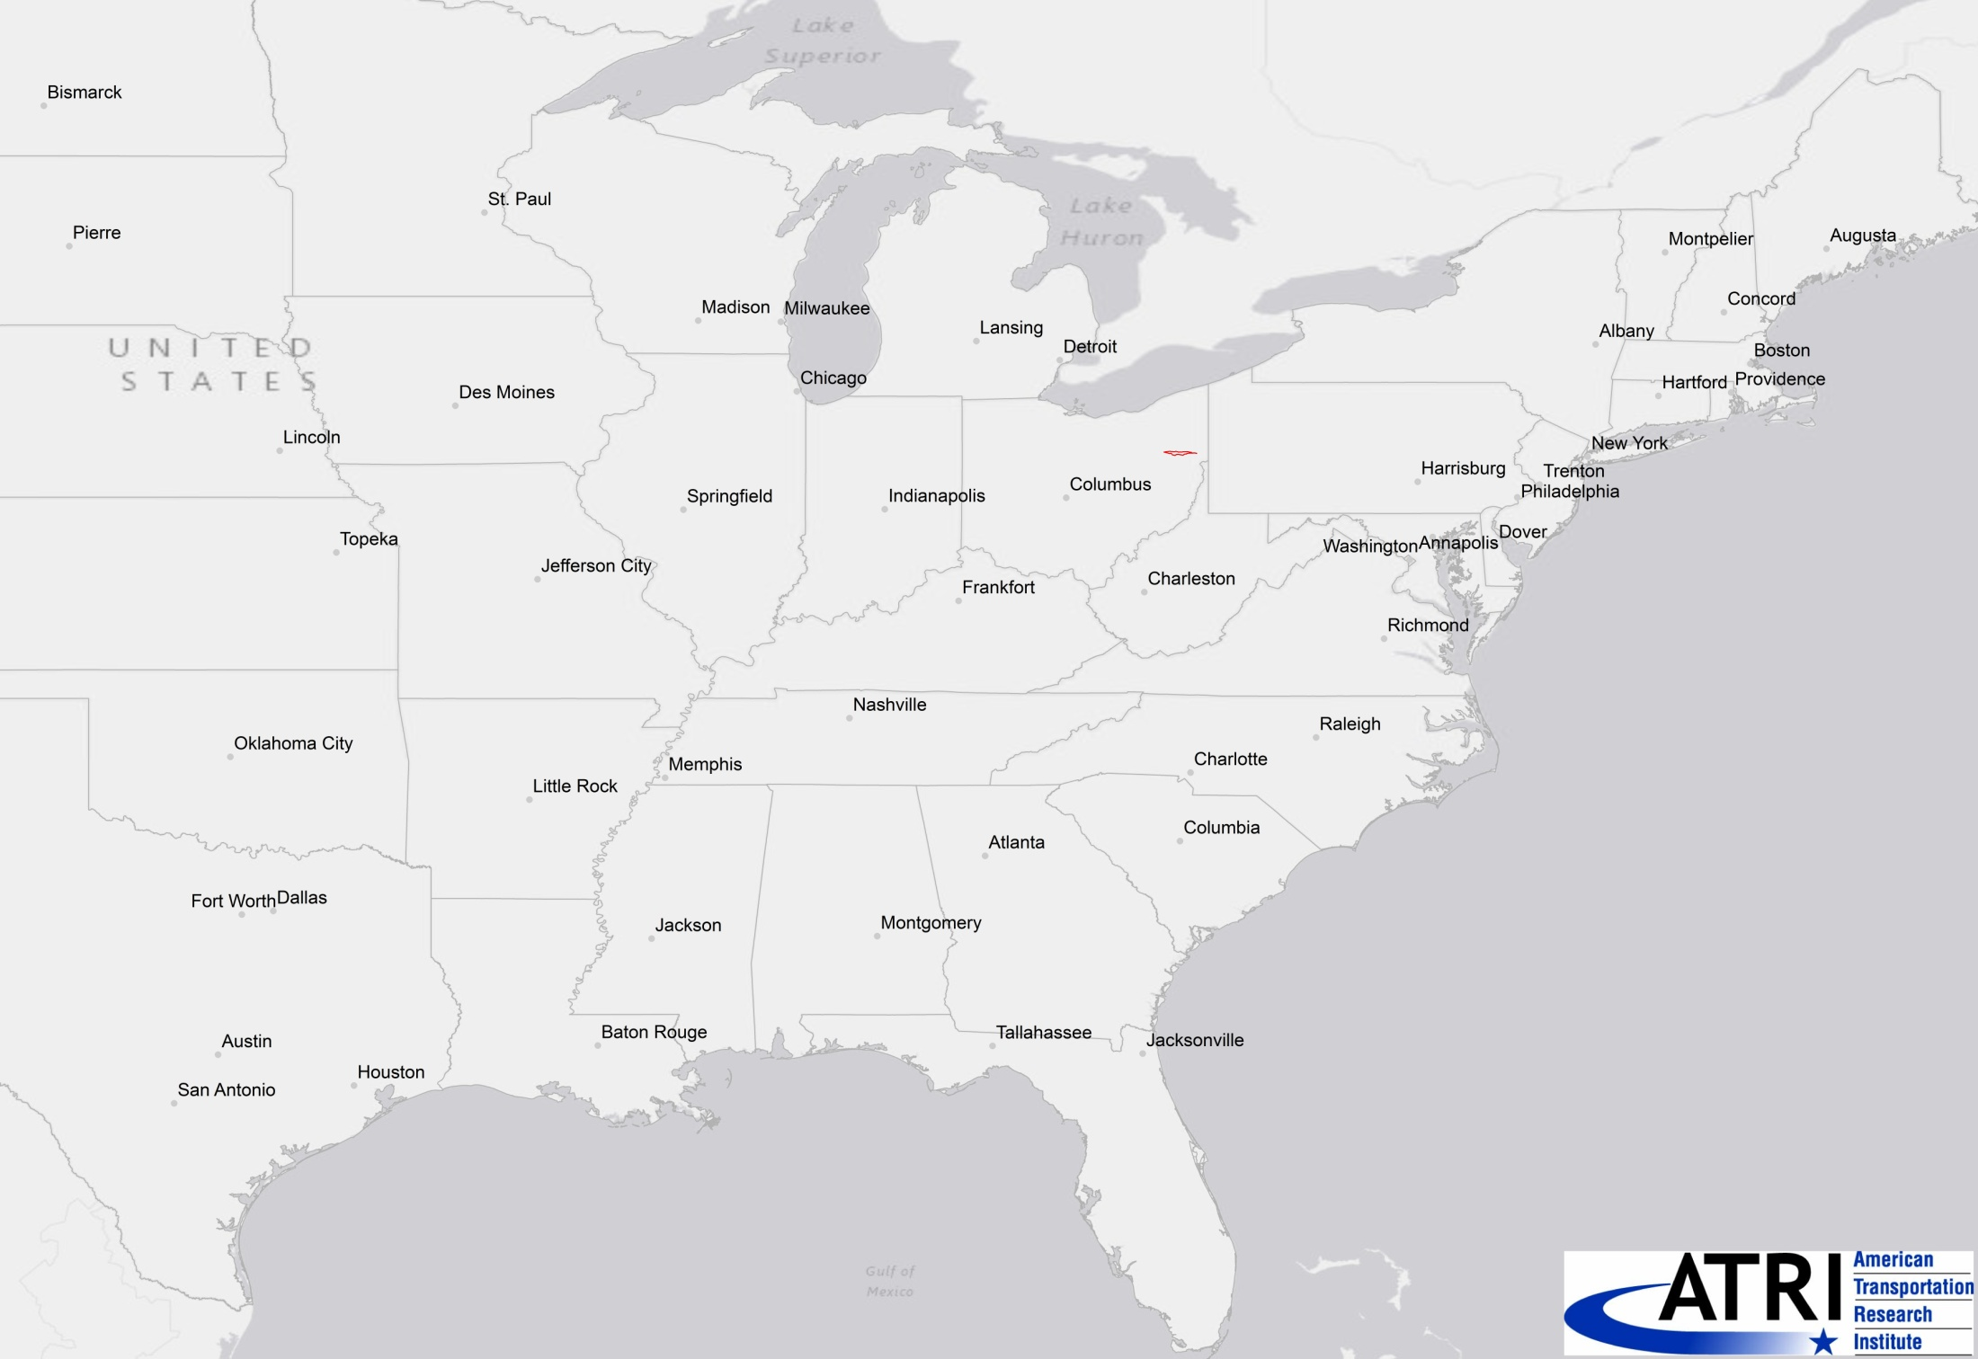
US 30 Study Area

Slide 23
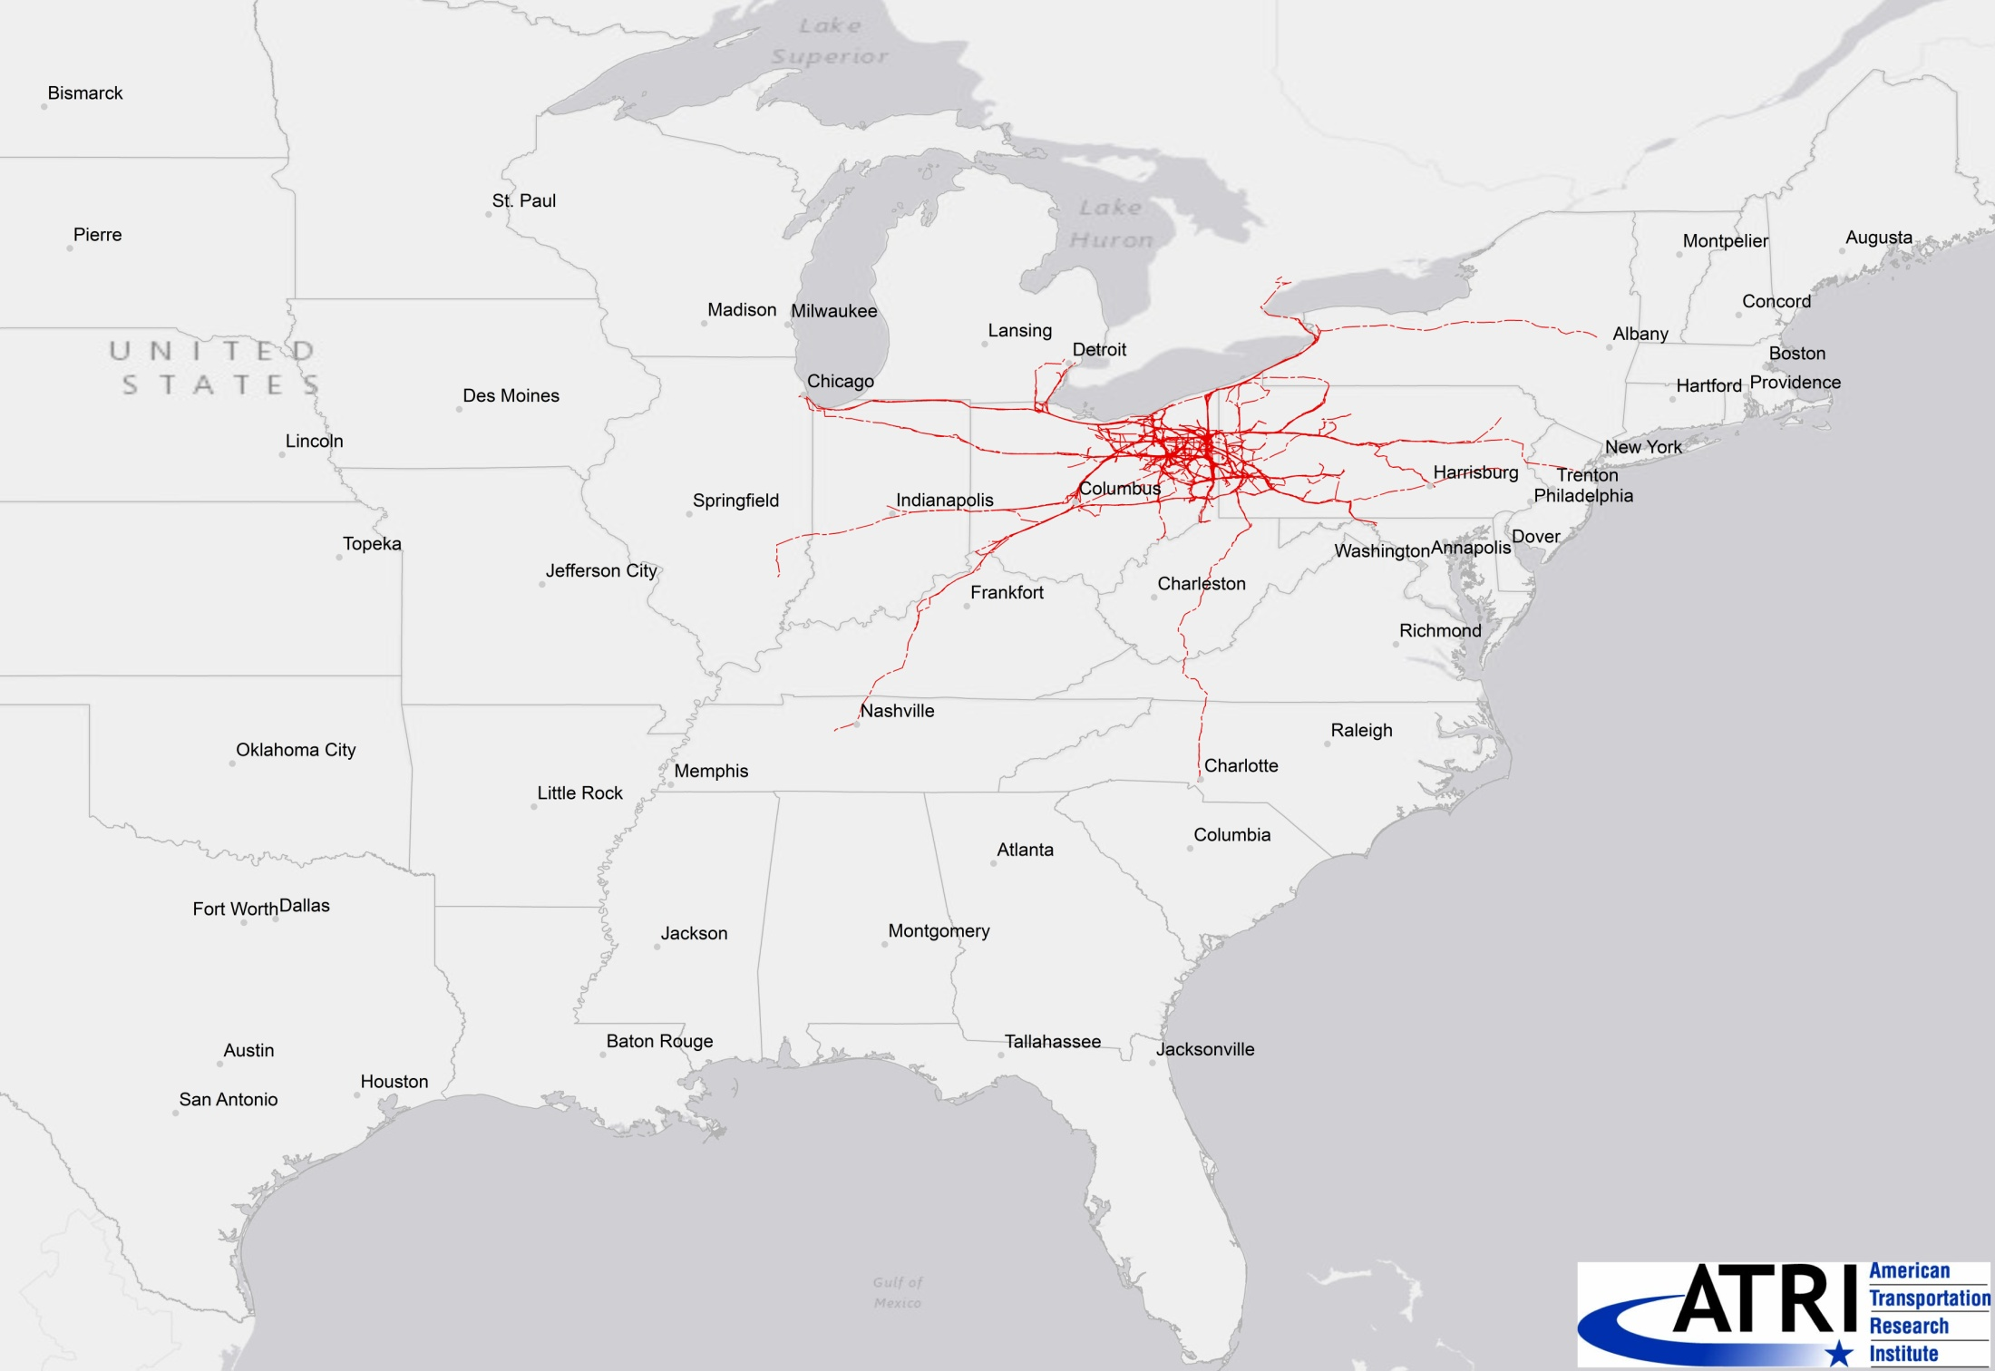
Trucks using the US 30 corridor – after 1 Day

Slide 24
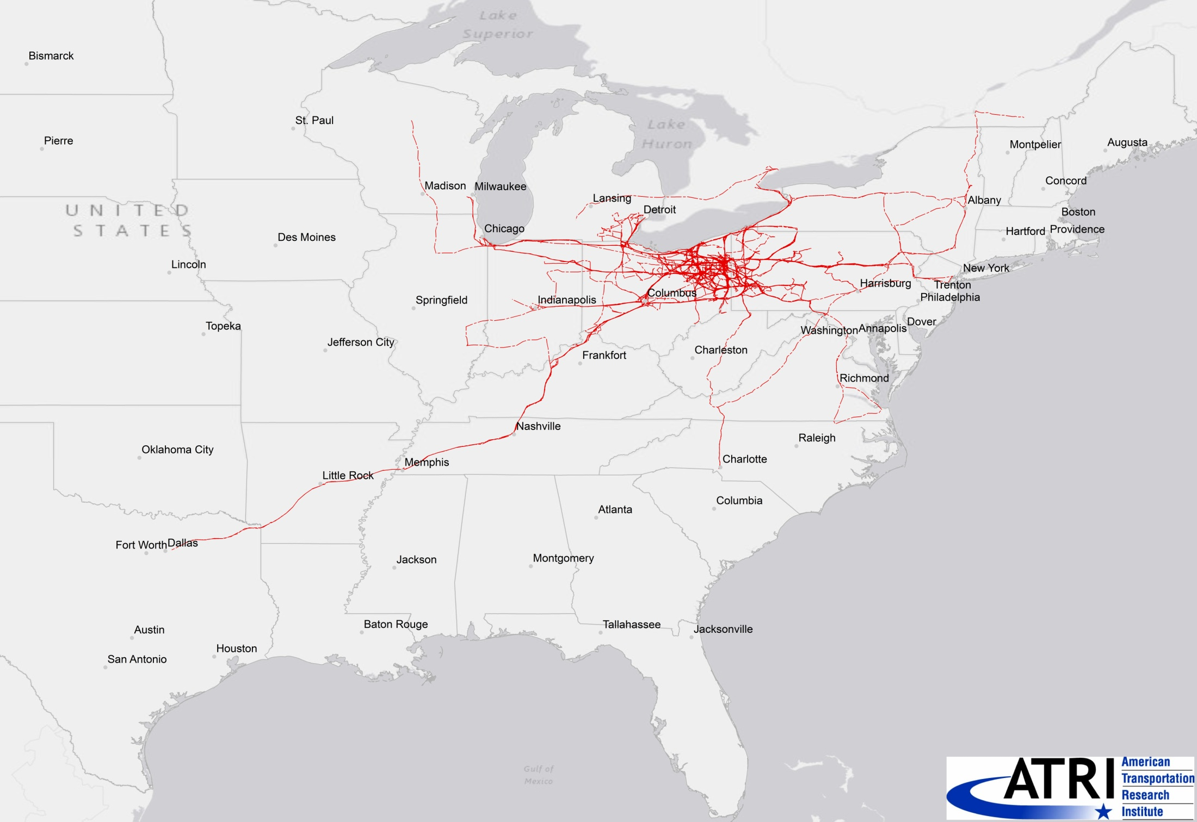
Trucks using the US 30 corridor – after 2 Days

Slide 25
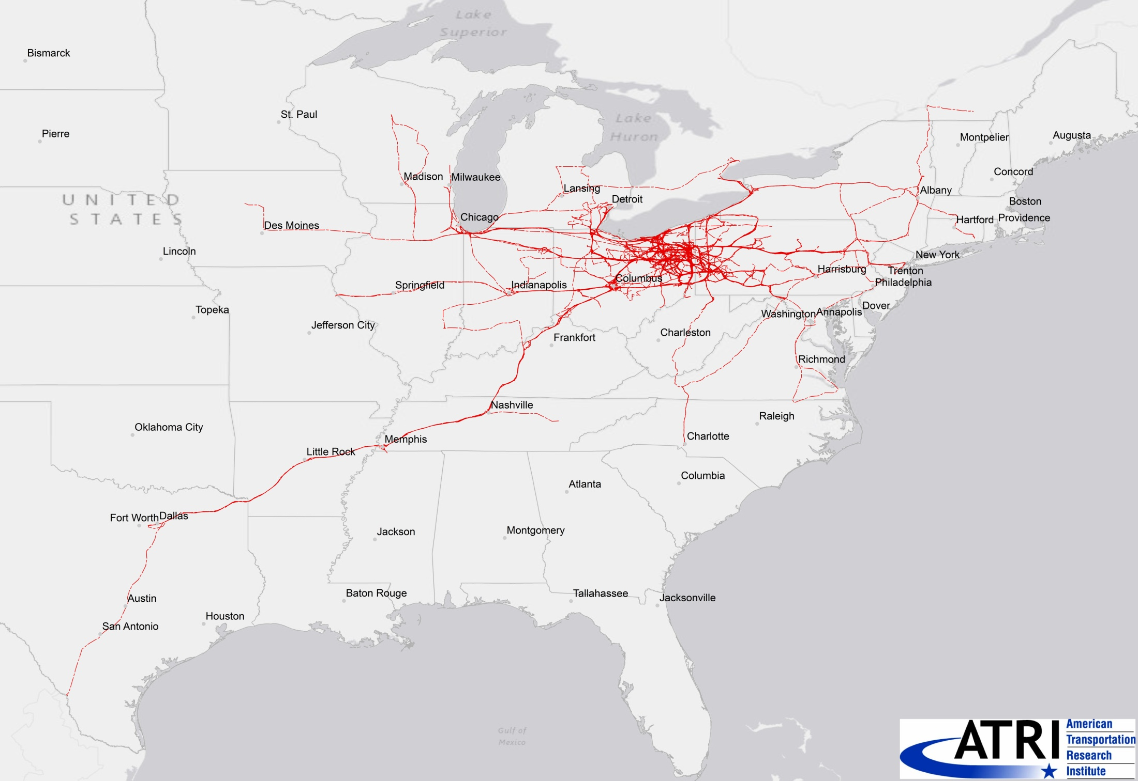
Trucks using the US 30 corridor – after 3 Days

Slide 26
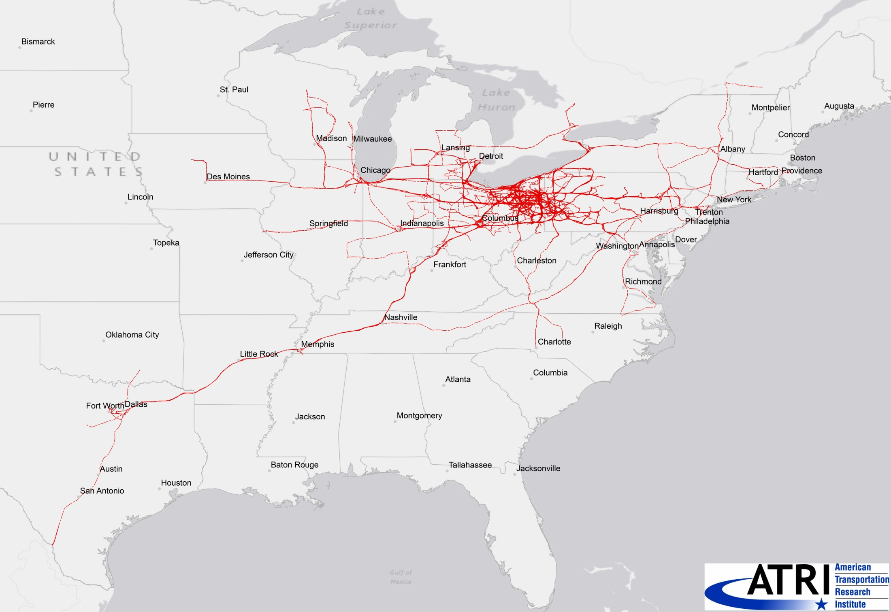
Trucks using the US 30 corridor – after 5 Days

Slide 27
Other Destination Choice Improvements
  Incorporate additional variables in utility functions
    river crossings
    county boundaries
    agglomeration from trip-chaining
    spatial autocorrelation
  Allow for different destination choice behavior in different regions of the state

Slide 28
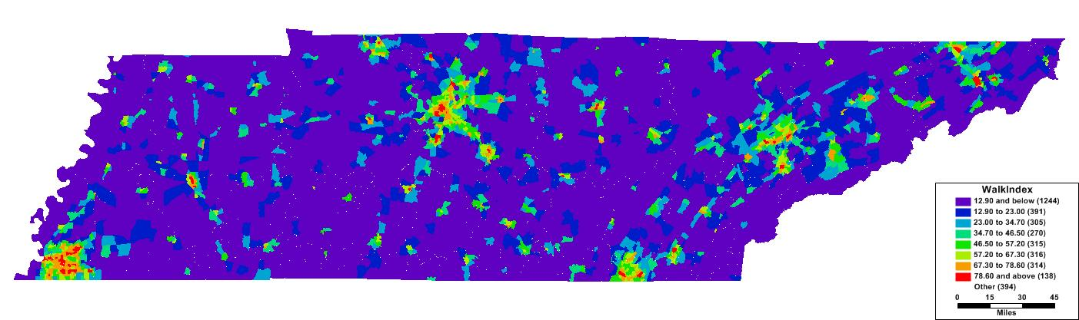
Add Simple
Mode Choice
    Multinomial logit model
    Sensitivities
      HH Size (HOV)
      Auto Ownership
      Transit Funding
      (divided by square root of
      population in service area)
      Walkability Index
        Retail density
        Intersection approach density

Slide 29
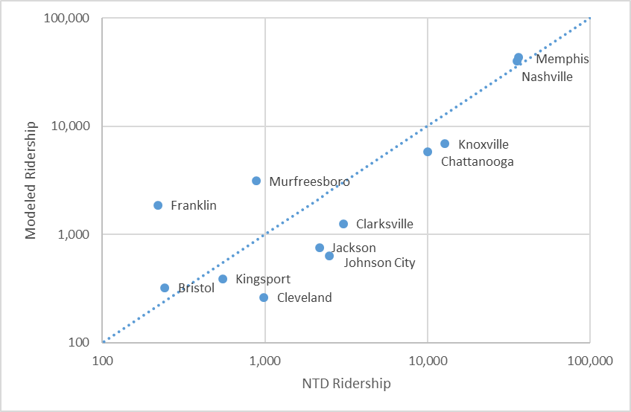
Transit Ridership

Slide 30
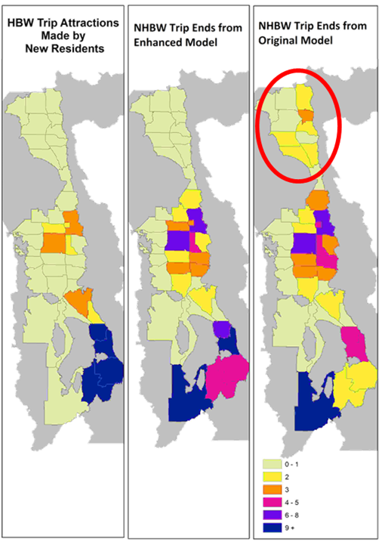
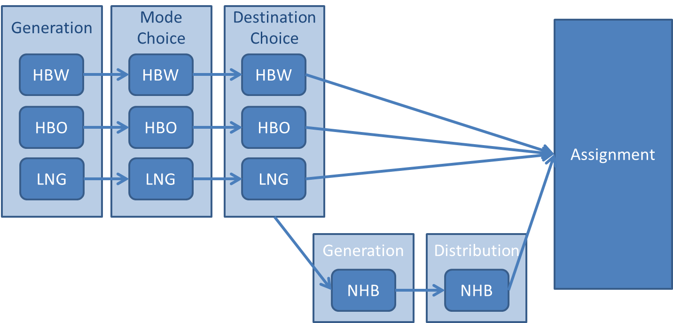
Link NHB Trips to HB Trips
  Unlinked NHB Trips
    Can imply physically impossible travel
    Can imply unlikely mode combinations
  Linked NHB Trips
    Studied for TMIP, now used in 7 states
    Modeling NHB trips conditional on HB
    trips creates consistency in location
    and mode of NHB trips with other trips

Slide 31
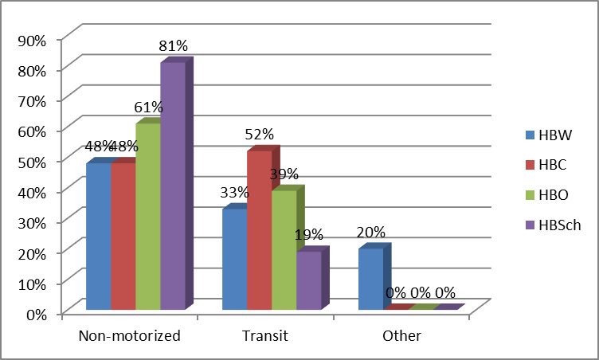
Link NHB Trips to HB Trips
  Generation of NHB Trips by Mode
    Generate trips by mode instead of mode choice
    Transition probabilities (that a HB trip of a particular purpose and mode is chained with a NHB trip of particular purpose and mode
Mode Shares of NHB Trips Generated by Transit HB Trips
NHBW HOV2
Coefficient | Estimate | t value
HBW_HOV2 | 0.2840 | 32.708
HBW_HOV3 | 0.0862 | 7.784
HBW_DR | 0.0808 | 24.407
HBW_TR | 0.0534 | 3.413
HBW_NM | 0.0326 | 2.514
HBO_HOV2 | 0.0173 | 4.744

Slide 32

Add CAV “Plumbing”
  Allow exploratory modeling analysis (EMA) to support scenario planning
  Adjustment factor “knobs”
    trip generation
    destination choice
    mode choice
    time-of-day
    capacities
  Add module for ZOV trips / deadheading

Slide 33
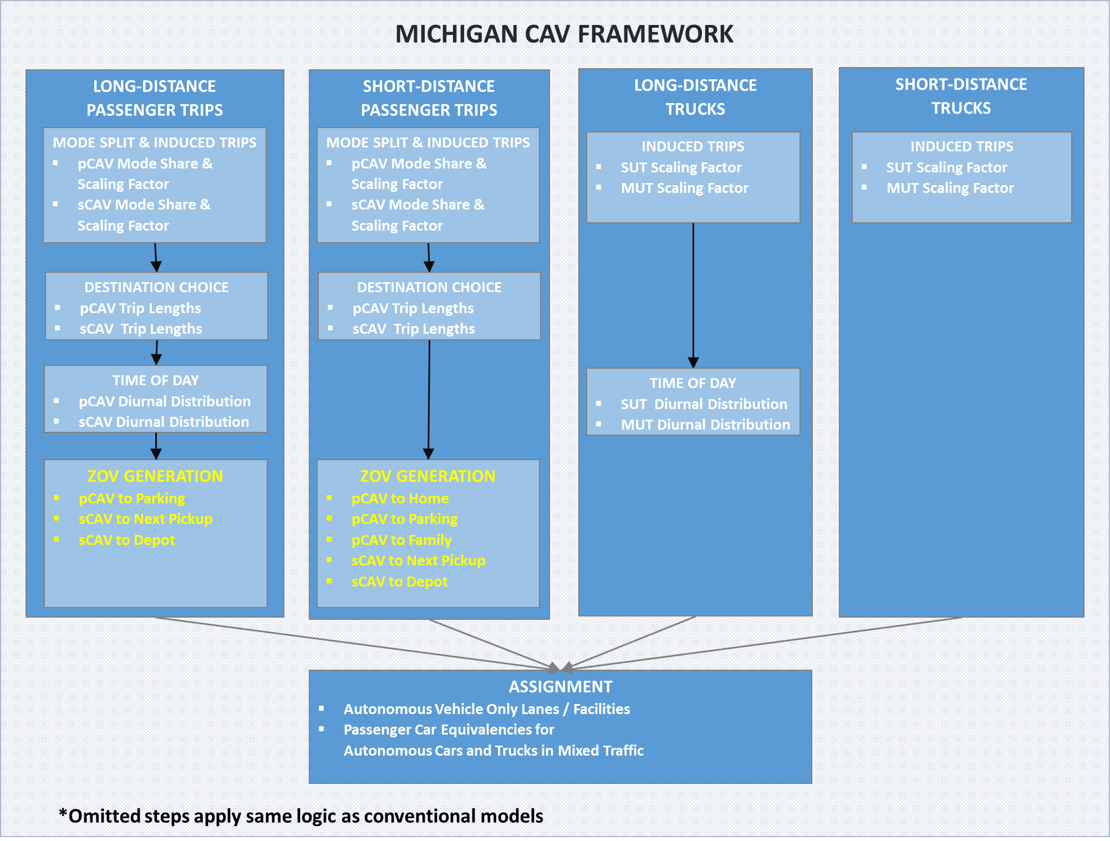

Slide 34
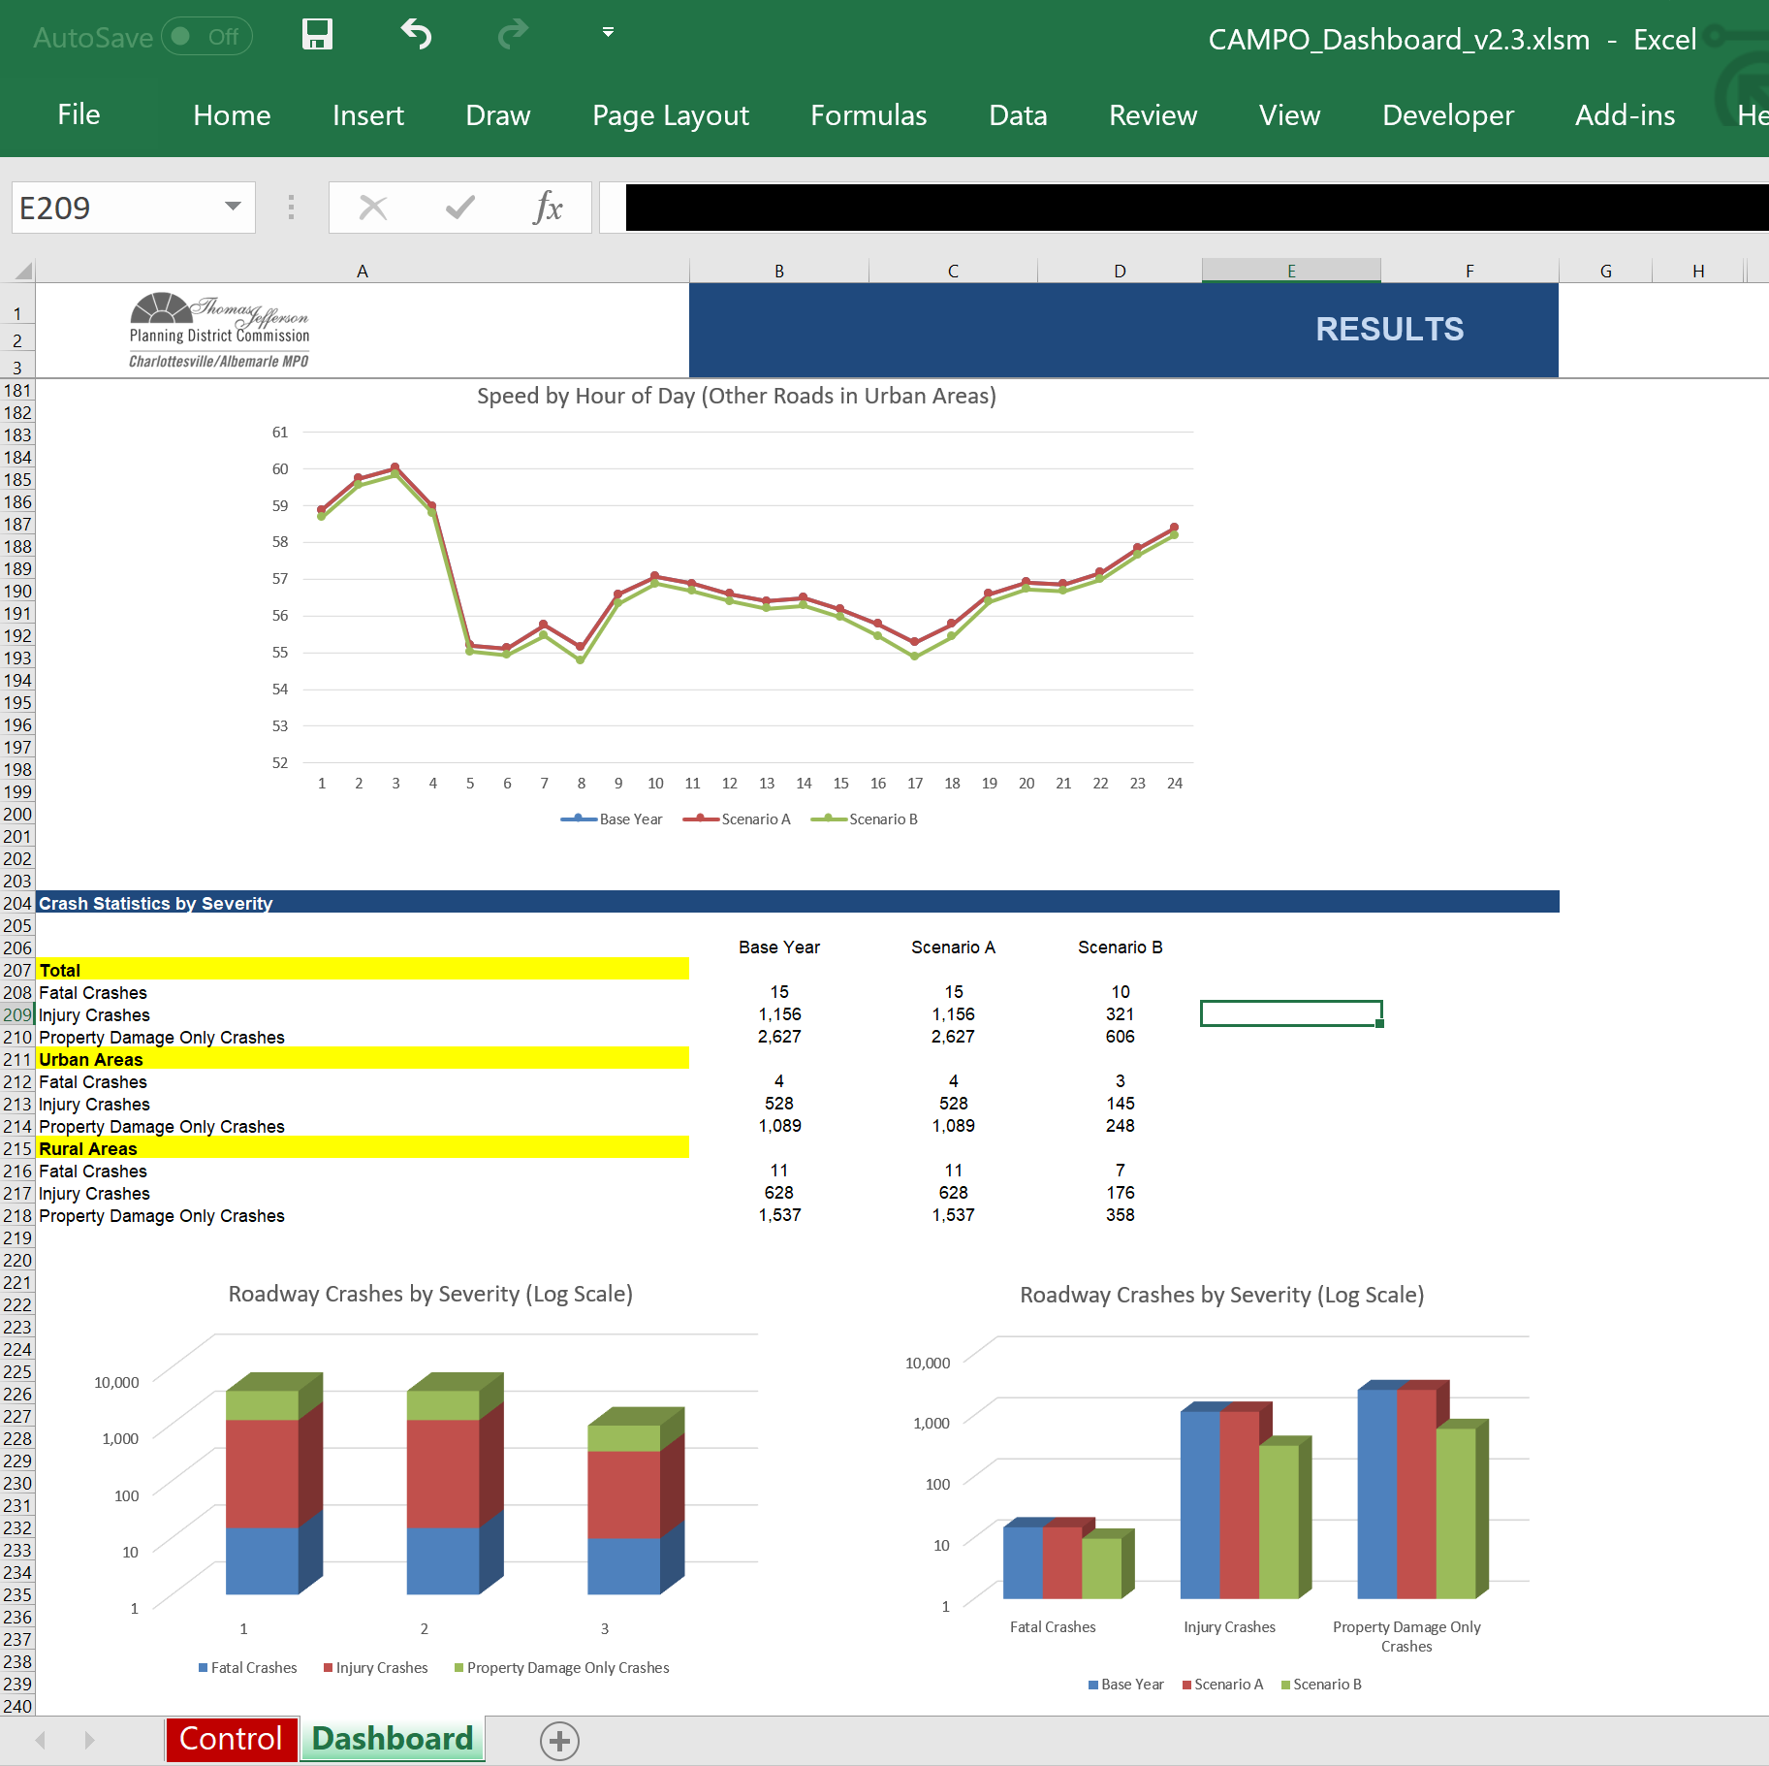
New & Improved Post-Processing & Reporting
  Delay per capita
  Crashes (HSM)
  Mode Shares
  Fuel Consumption
  Emissions

Slide 35
New & Improved Benefit/Cost Analysis
  (And improve method to look at GC instead of just time for pathfinding)
  Add established benefits
    Vehicle Operating Cost Savings
    Travel Time Reliability
    Crash Costs Savings
  Test emerging benefits in P6.0 (for inclusion in P7.0)
    Options value of additional destinations & modes
    Public health benefits of active transport
    Non-user benefits? Emissions? Noise? Water?

Slide 36
Dynamic Validation
  Use traffic counts and passive OD data
  from two points in time
  Calibrate to both 2015 and 2017/8?

Slide 37
Potential NCSTM 5.0 Improvements

Slide 38
Responding to Smart Tech
  Research new data collection and modeling methods necessary to incorporate and forecast behavioral changes related to adaptation to emerging smart technologies / new modes
    Explore disaggregate data fusion of survey trace data, passive trace data, third-party marketing, and POI data with expansion to traffic counts
    Explore dynamic machine learning from longitudinal passive data and test boosting versus blending with the traditional structural model to support agile model updating

Slide 39
Special Travel Markets
  Update Visitor model using passive data and link it to Long Distance model
  Integration with the National Freight Model (for port diversion, etc.) and/or develop new freight model
  Integration with the national Long Distance Model (HSR, hyperloop, etc.)
  Improve sensitivity/use for non-congestion projects in prioritization list

Slide 40
Implement More New Benefit/Cost Analysis
  Implement chosen new benefits in P7.0
    Options value of additional destinations & modes
    Public health benefits of active transport
    Non-user benefits? Emissions? Noise? Water?

Slide 41
Priorities

Slide 42
“All models are wrong, but some are useful.”
– George Box, famous statistician

Slide 43
NCSTM Applications
CURRENT USES
  Project Prioritization
  Traffic forecasting in rural areas / inter-urban corridors
POSSIBLE USES
  External / Freight Trips for MPO / SAM models
  Base tool for evacuation modeling
  Rural reliability calculator
  Enhanced traffic forecast utility
  Congestion management tool – static files

Slide 44
How do you want to use NCSTM?
  NCDOT wants your input!

